Slide 1
Title: Housing Prediction Analysis
Author: Kishan Kalaria

Slide 2
Introduction
The purpose of this project is to create multiple predictive models to determine which provides the most accurate predictions as it relates to the sale price of a home. This project also allows us to test multiple variables and see which combinations, and which models produce the most accurate results.
*Please add slides as required.

Slide 3
The Data
Our data is stored in a csv file called houseSmallData. It has approximately 100 rows and more then 50 columns. Data is both numeric and non-numerical. Numeric data includes sq footage, garage space, and more. Non-numeric data includes lot shape, utilities, zoning ect.
*Please add slides as required.

Slide 4
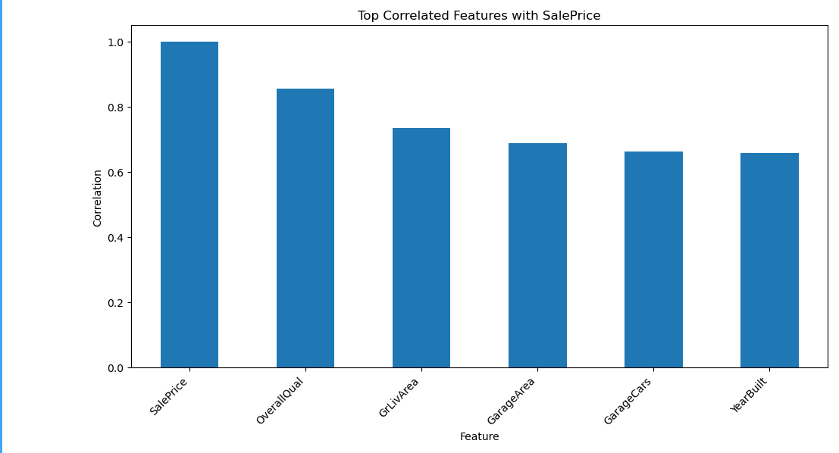
Data Exploration
*Please add slides as required.

Slide 5
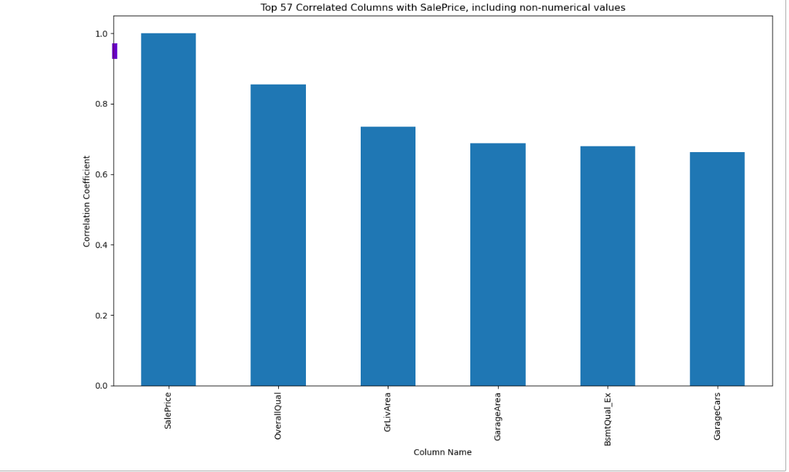

Slide 6
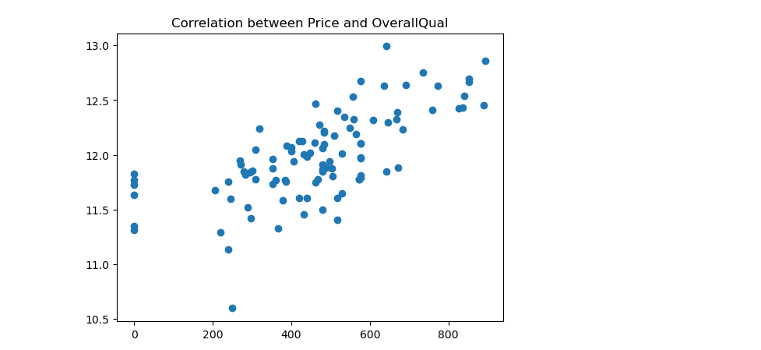

Slide 7
Data Preparation
Load the data into a dataframe.
Analyze the data, ie numerical vs non-numerical rows, how many NaNs ect..
Clean the data, ie remove non-numerical data.
Create correlations between the variables to sale price.
Determine which variables to train and apply to linear aggression model
*Please add slides as required.

Slide 8
Correlation
I found that the more variables the better the model. Reducing the number of variables flowing into the model, even only selecting the highest correlated ones causes the model to perform poorly. Second I observed that there is not much difference if non-numerical values are included. I used an encoding function to give non-numerical values a numeric value to be used in a model, but only one non-numeric value made it to the top six most correlated values.

Slide 9
Project Description
I used the linear regression model. I believed that this model was the best to use because we were comparing multiple variables to one variable in this case the SalePrice.
The linear regression model comes in handy for many variables and a few number of variables. In this case my models used up to six variables and as few as one variable.
*Please add slides as required.

Slide 10
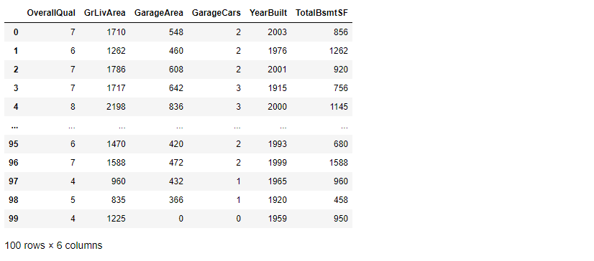
Analysis and Results Model 1
{0.7483862926719747}
*Please add slides as required.

Slide 11
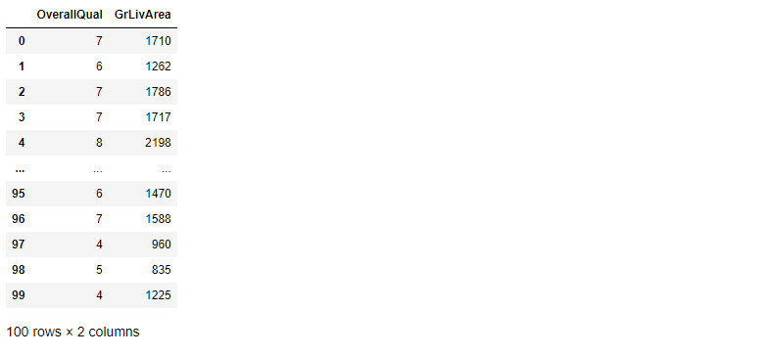
Model 2 Results
{0.692742149014746}

Slide 12
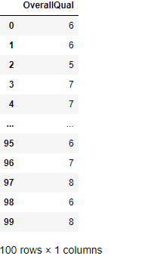
Model 3 Results
{0.573239793536416}

Slide 13
Verification
My best model was the one that used six of the most highly correlated variables. The less variables used the worse the model got, even if the most highly correlated variable was used against Sale Price.
*Please add slides as required.

Slide 14
Conclusion
While I think the linear regression model works well in this scenario, I believe that the data we were given required good massaging. As a example there were more non-numeric data points then numeric. When only passing in numeric values into the model it leaves out a lot of possible analysis in a regression model.
*Please add slides as required.

Slide 15
References
Use this as a sample for websites:
Stojilkovic, Mirko. “Linear Regression in Python.” Real Python, https://realpython.com/linear-regression-in-python/ .
*Please add slides as required.

